Slide 1
Comparing and Contrasting Films

Slide 2
LO. To identify features in writing about a film clip.
Watch https://www.youtube.com/watch?v=1G371JiLJ7A

Slide 3
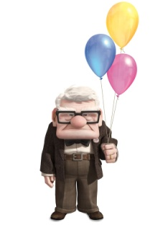
Venn diagram
We are going to compare and contrast these two films.
Write features you find on the correct places on the Venn diagram.
‘The Piano’
‘ Up’

Slide 4
Speaking frame
In some ways………and…..are alike.
For instance they both……………………….. Another feature they have in common is that……………………… Furthermore they are both……………… However they also differ in some ways.
For example……………..while……………. Another difference is that .....................,whereas……………….. Finally………………but…………...

